Slide 1
No matter what my brand sells. Brand attachment and consumers response to stigmatized line extension
Nawel Felllah-Dehiri , IAE Paris, Sorbonne Business School

Slide 2
Purpose
Stigmatized consumer are social group who have negative social evaluation : African Americans (Crockett, 2017), Oversaized consumers (Scaraboto et Fischer 2013 ), gay community (Kates, 2004), Muslims consumers (Johnson, Thomas & Grier; 2017)
In order to respond to stigmatized consumer needs, many mainstream brands launches different products.
Can line extension targeting stigmatized consumers impact non-stigmatized consumers behaviors? Is this inclusion strategy beneficial for brands ?

Slide 3
Design methodology
Study 1- Targeting stigmatized consumers - Symbolic product Vs utilitarian product.
n=70 non-stigmatized consumers
We examine the difference between line extension targeting stigmatized consumers : symbolic product Vs Utilitarian
Study 2- Effect of stigmatized line extension on social Identity Threat
n=133 non-stigmatized consumers
We examine the direct and indirect effect of stigmatized line extension through social identity threat.
Study 3- Brand attachment moderator effect
n=140 non-stigmatized consumers
We examine the interaction effect of brand attachment

Slide 4
Finding
1- Stigma by association (SBA)
When a brand is targeting stigmatized consumer, we find support that it leads to stigmatized line extension. A difference in SBA is found between symbolic product and utilitarian product.
2- Direct effect of stigmatized line extension on social Identity Threat
Social identity threat is the mediating mechanism through which stigmatized line extension increases negative behaviors toward mainstream brands.
3- Brand attachment moderator effect
Brand attachment has a positive moderating effect on stigmatized line extension, on negative customer behaviors and social identity threat.

Slide 5
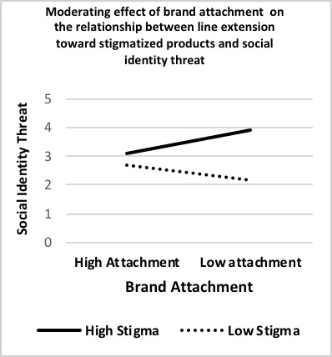
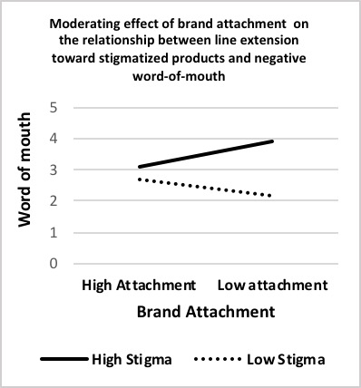
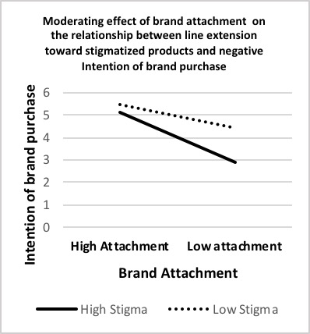
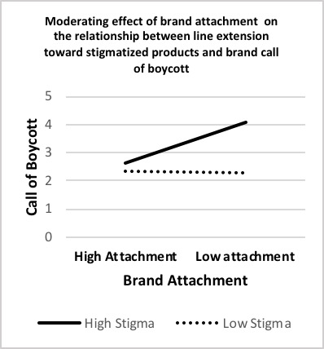
Finding
Stigmatized line extension impact indirectly and negatively consumers behaviors, via social identity threat.
We validate that brand attachment moderates the likelihood of non-stigmatized consumers negative behaviors toward stigmatized line extension.
SP
UP
SP
UP
SP
UP
SP
UP
SP : Symbolic Product
UP: Utilitarian Product

Slide 6
Reaserch implication
The importance of line extension strategy and brands targeting different social groups cannot be understrated.
Stigma by Association (Goffman, 1963)
Targeting stigmatized consumers leads to stigmatized line extension (Barlow, Verhaal et Hoskins, 2018)
Social Identity (in-group & out-group):
Stigmatized line extension can threaten social identity of non-stigmatized consumers (Homburg et Ukrainets, 2021)
Brand attachment “Buffer effect”
Brand attachment has a positive moderating effect on stigmatized line extension on negative customer behaviors and social identity threat.
Brand attachment attenuates negatives behavior and acts like a "buffer effect" (Ahluwalia, 2000; Tax, Brown et Chandrashekaran, 1998)
.

Slide 7
Reaserch implication
Social implication
Introducing line extensions to satisfy stigmatized consumers in a mainstream market is a challenge for marketer.
The study contributes to a better understanding of societal phenomena between different social groups in the market.
Managerial Implication
Consumer who are non-attached to the brands are those who are more engaged in negatives behaviors
Our study proposes a rich theoretical framework rooted in stigmatization, social identity threat and brand attachment

Slide 8
THANK YOU
Main references:
Barlow et al., 2018
Chae, Dahl and Zhu, 2017
Dalman et al., 2019
Japutra et al., 2018
5. Johnson et al., 2017
6. Roulet, 2019
7. Slade Shantz et al., 2019
8. Wright & Annes, 2013
Dr. Nawel Fellah-DEHIRI
IAE Paris Sorbonne, Paris 1 Sorbonne
nawel.fellah.dehiri@gmail.com

